Slide 1

NOISE POLLUTION MONITORING

Slide 2
PROBLEM STATEMENT
In the wake of accelerating urbanization, the pervasive issue of noise pollution has become a significant concern, attributed to factors such as population growth, expanded transportation networks, and increased industrial activities. Noise pollution adversely affects the quality of life in urban areas, potentially leading to health problems and disrupting daily activities.

Slide 3
The primary goal is to conceive and develop an innovative noise monitoring solution that leverages IoT technology, cloud-based infrastructure, and user-friendly interfaces. This system should be cost-effective, adaptable to various urban contexts, and serve as an indispensable tool in the ongoing quest to combat noise pollution and enhance the acoustic environment within urban areas.

Slide 4
METHODOLOGY
Sensor Deployment: Install noise sensors at strategically chosen locations within the target urban area, ensuring representative coverage.
Data Collection: Continuously collect sound level data using the deployed sensors, capturing variations over time.
Data Transmission: Use IoT technology to transmit the collected data to a centralized cloud-based platform in real- time for further analysis.
Data Analysis: Employ data analytics techniques to process and analyze the noise data, identifying patterns, sources, and trends in noise pollution.
Alert Generation: Implement algorithms to generate alerts when noise levels exceed predefined thresholds, ensuring timely response by relevant authorities.
Data Storage: Store the noise data securely in a cloud database, allowing for long-term storage and easy retrieval for research and reporting.
Visualization: Create user-friendly dashboards and data visualization tools for real-time monitoring and public engagement.
Maintenance: Regularly maintain and calibrate sensors to ensure data accuracy and system reliability.
Community Engagement: Engage with local communities and authorities to raise awareness about noise pollution and encourage participation in reduction efforts.
Continuous Improvement: Monitor system performance, seek feedback, and make enhancements to improve noise pollution monitoring and control.

Slide 5

noise barrierr
traffic management
brake blocks for trains
electric cars
noise pollution
building insulation
quiet road surfaces
soundscape
land use planning & design
changing driving styles
building design

Slide 6
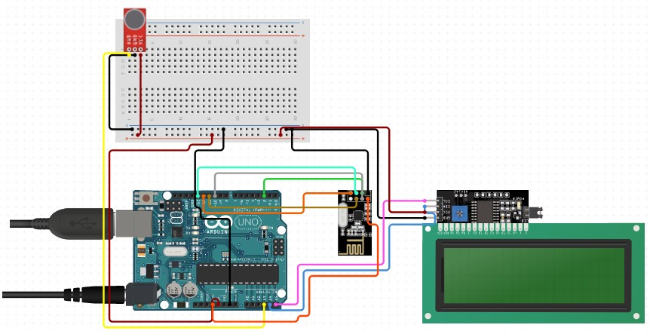
HARDWARE COMPONENTS
Arduino Uno
Microphone sensor module
Breadboard and jumper wires
Resistor (220-330 ohms)
USB cable for Arduino Uno
Computer with Arduino IDE installed
LCD screen

Slide 7
PROBLEM SOLUTION
To address the issue of noise pollution effectively, we propose the development and implementation of an advanced Noise Pollution Monitoring System (NPMS) equipped with IoT technology and cloud-based data storage and analysis capabilities. This innovative system aims to:

Slide 8

Continuous Monitoring: NPMS will continuously measure sound levels in various urban environments using strategically placed sensors, ensuring comprehensive coverage.
Real-time Data Transmission: The system will utilize IoT technology to transmit noise data in real-time to a cloud-based platform for immediate analysis and visualization.
Data Analysis: Advanced data analytics tools will be employed to process and analyze the collected noise data, identifying patterns, trends, and noise sources.

Slide 9
By implementing the Noise Pollution Monitoring System, urban areas can proactively monitor, analyze, and manage noise pollution, leading to improved quality of life, reduced health risks, and more sustainable urban development.

Slide 10
CONCLUSION
the Noise Pollution Monitoring System represents a crucial step toward improving urban living conditions. By leveraging IoT technology and data- driven insights, it empowers communities and authorities to proactively address the challenges posed by noise pollution, fostering quieter and healthier urban environments for the well-being of all residents.

Slide 11
THANK YOU

